Slide 1
Using LLMs to semantically categorize children’s productions of negation
Solar Lab, July 7th, 2026

Slide 2


Background: Cross-linguistic corpus analysis
No (denial)
Not
No (rejection)
No (nonexistence)
No (prohibition)
~ 15 months
~ 27 months
Bloom, 1970

Slide 3
English
Tagalog
REJECTION
NONEXISTENCE
REJECTION
NONEXISTENCE
PROHIBITION
NEGATION
PROHIBITION
NEGATION
“no”
“ayaw” “huwag” “wala” “hindi"
Notes:
If that’s the way no behaves in the child’s lexicon, and if those early concepts, which are more perceptual and affective, are easier, then a child might end up with a meaning space for “no” that looks something like this
And this is what they would have to then add logical negation to
Compare this to a language like tagalog, where each of these communicative functions is expressed by a separate word

Slide 4
Data classification
Bloom (1970)
Rejection | “Do you want broccoli?” “No!” “I don’t want broccoli”
Nonexistence | ”There’s no juice” “Mommy doesn’t have any juice”
Denial | “That’s not fire” “I can’t drink water”
Proxy for logical negation
Do expressions of Denial emerge earlier in a language like English or a language like Tagalog?

Slide 5
Human coded data

Slide 6
Inter-coder reliability – theoretical ceiling

Slide 7
Coding pipeline
Transcripts + human coding
child–caregiver corpora · 2 coders
Build token dataset
9,628 negator tokens + context
Evaluation splits
dev_train · dev_check · test_lockbox
Score vs. humans
agreement % · Cohen’s κ
Validated JSON output
Bloom label + 6 flags per token
LLM coding
gemma4:31b · prompt + policy + schema
error analysis → revise prompt & policy (v1 → v2 → v3)

Slide 8
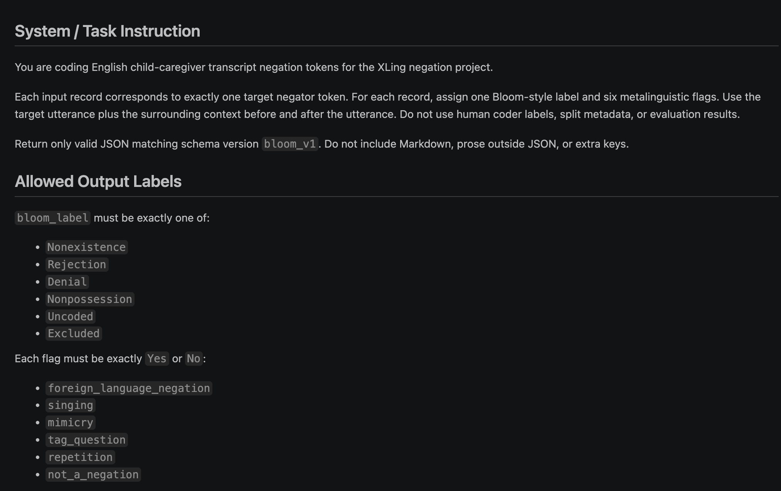
Prompt v1

Slide 9
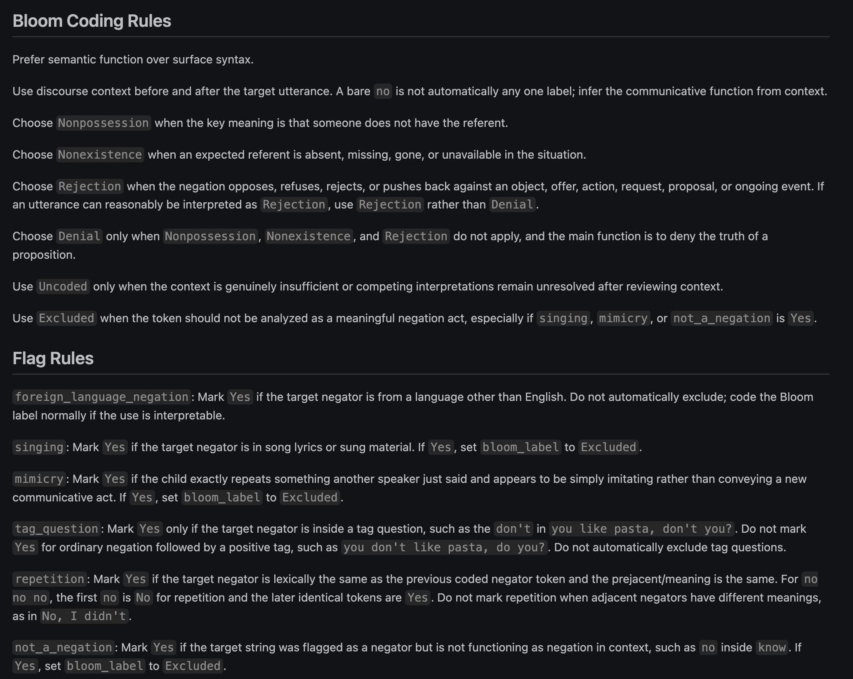
Prompt v1

Slide 10
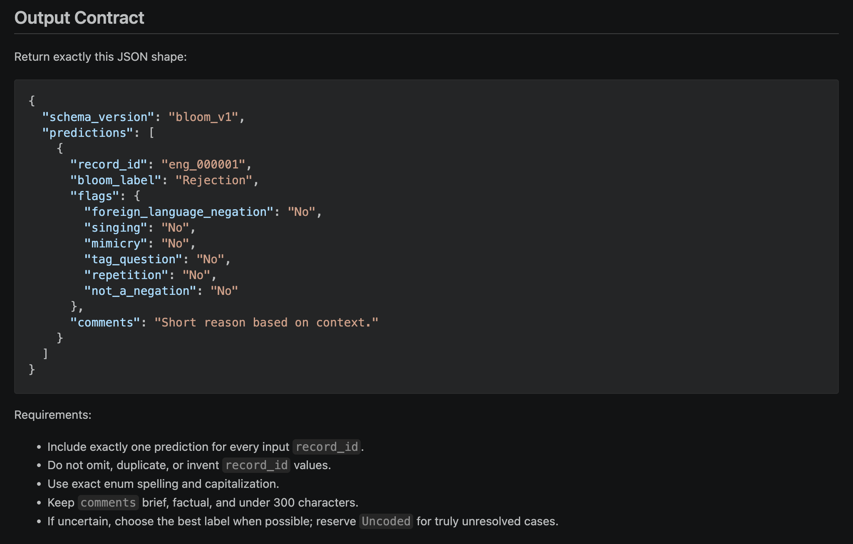
Prompt v1

Slide 11
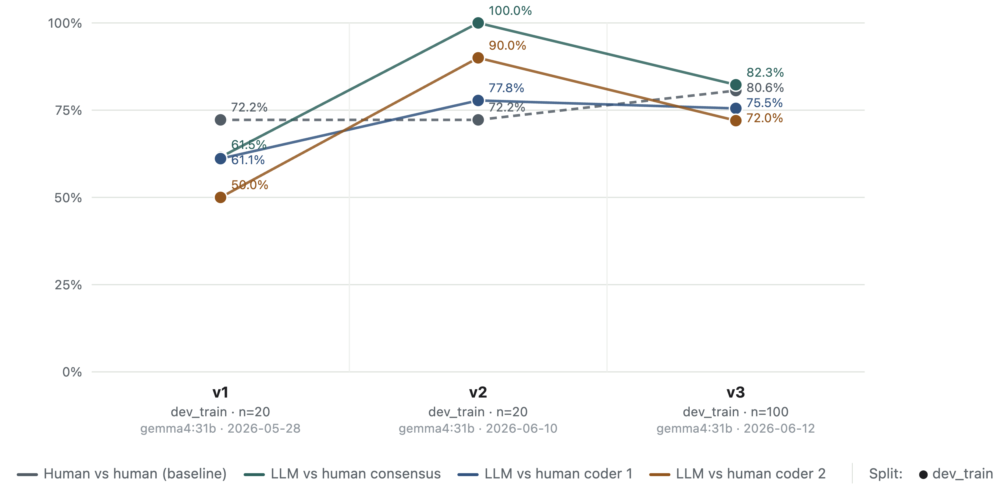
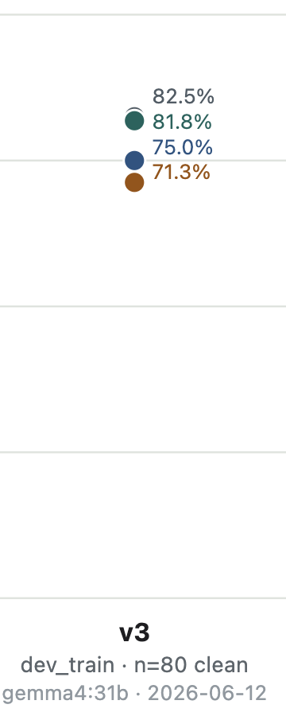
LLM–human agreement across versions
Prompt contaminated
80 unseen lines

Slide 12
What changed: v1 → v2
Why: v1 agreement (50–61%) sat below the 72% human–human ceiling; one error analysis drove every change.
Reason before label. Output writes comments first, then bloom_label — closes the “reasoned X, emitted Y” gap (the main structural fix).
Rejection tightened. Must oppose a thing/offer/action in play; a negation that answers a statement is Denial — curbs v1’s over-use of Rejection.
Negative imperatives split. Stop a specific action = Rejection; restate a rule or norm = Denial.
Excluded narrowed. Only valid with a licensing flag; unintelligible-but-real negation now codes Uncoded.
Repetition made within-utterance. Token-position fields added so the model knows which negator token it is coding.
Six worked examples added, one per observed v1 error.
BUT the prompt examples were precisely the lines to be coded -- lol

Slide 13
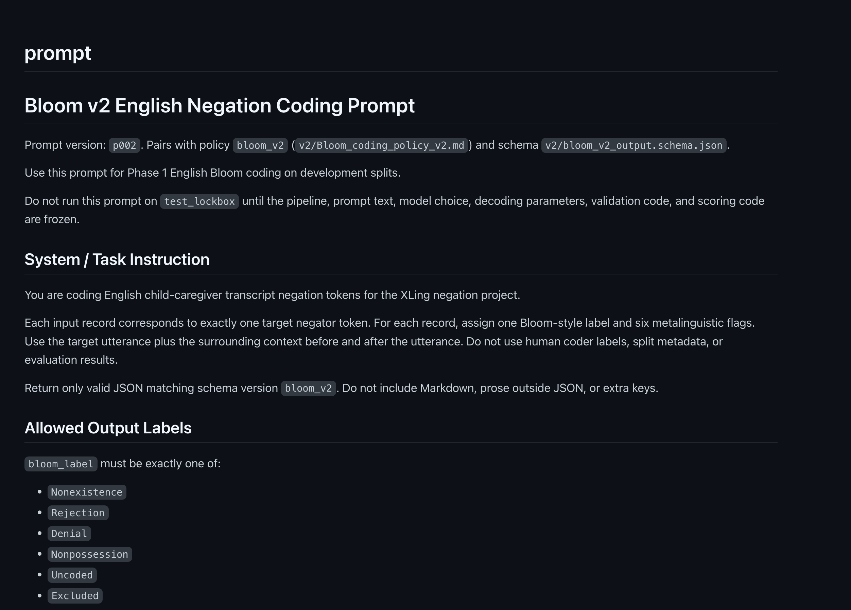
Prompt v2

Slide 14
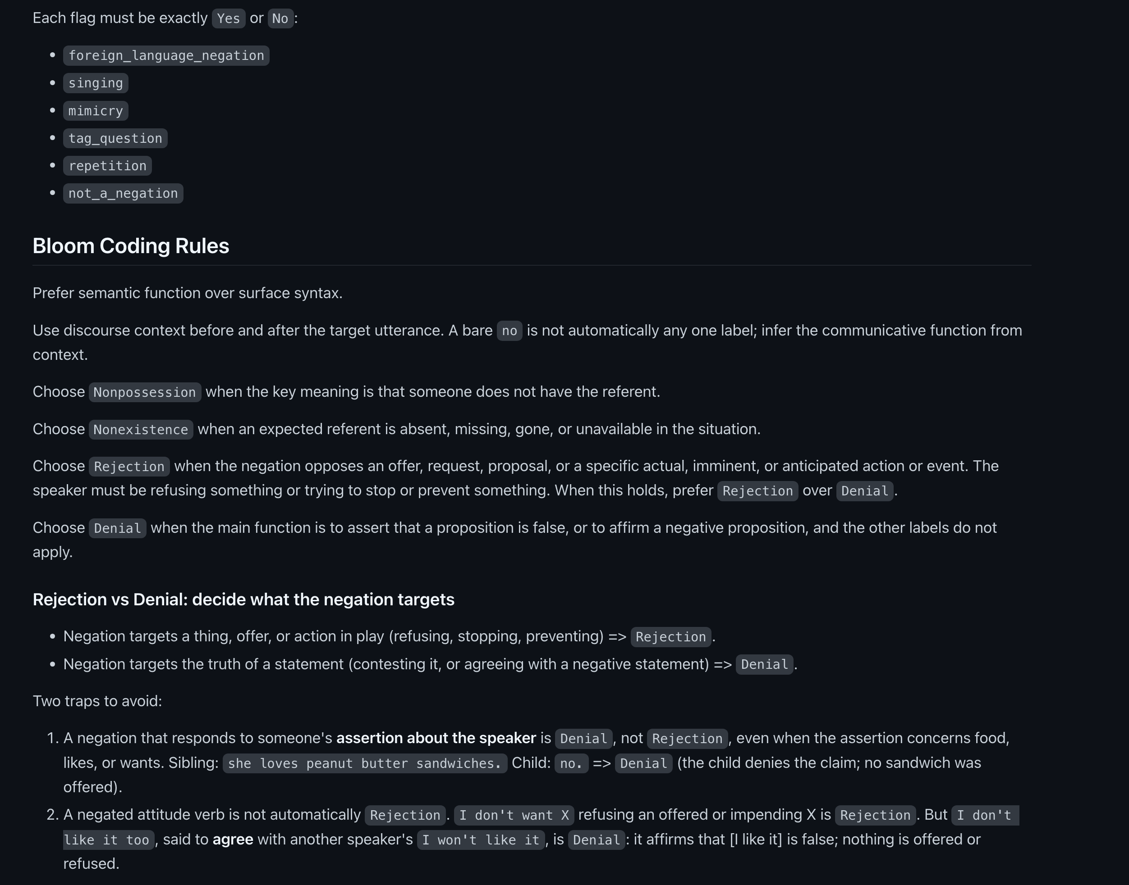
Prompt v2

Slide 15
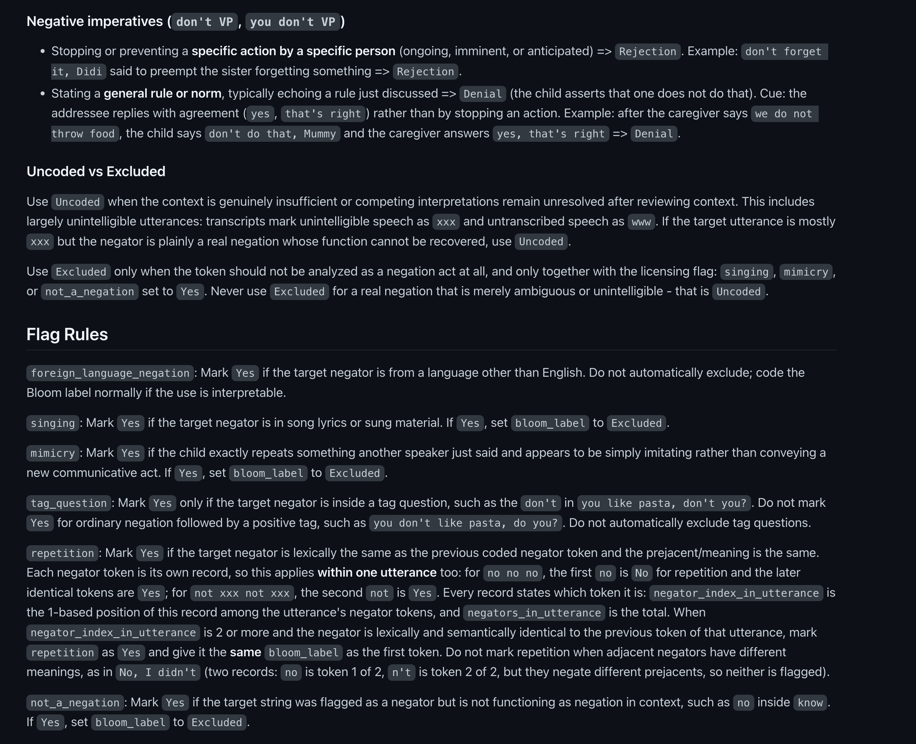
Prompt v2

Slide 16
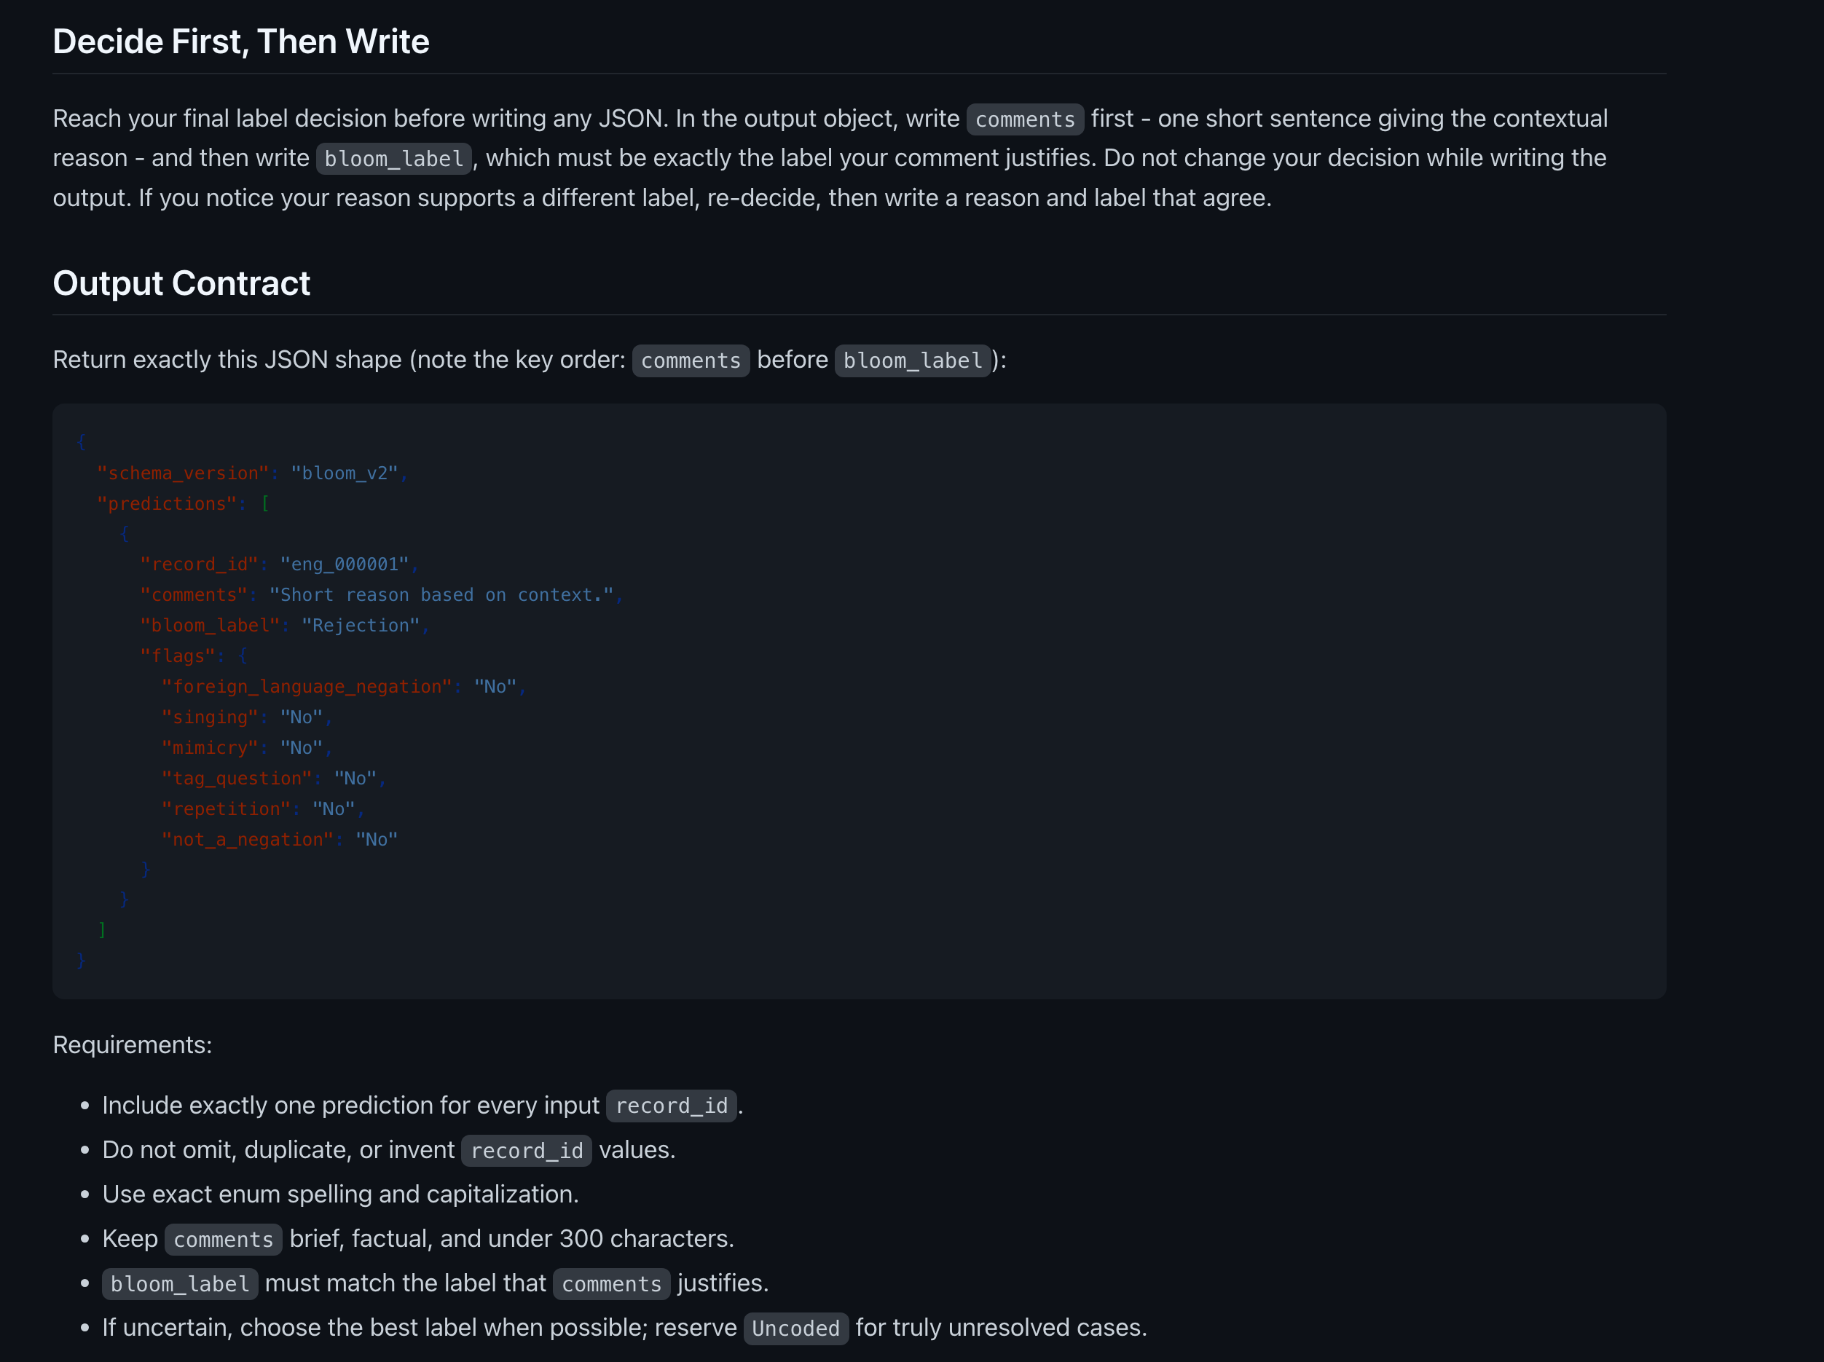
Prompt v2

Slide 17
LLM–human agreement across versions
Prompt contaminated
80 unseen lines

Slide 18
What changed: v2 → v3
Why: v2 already beat the human ceiling; v3 refines the remaining split-vote rows and hardens the pipeline.
Interlocutor uptake is now the top principle. How speakers respond reveals how they read the negation: pleading/bargaining → Rejection; re-asserting/correcting → Denial.
“Two traps” → “three traps.” A statement that functions as a proposal or request (“…okay?”) is Rejection, not Denial.
Attitude verbs sharpened. Resisting an item in an active exchange (with a counter-proposal) = Rejection.
Restate every label before emitting JSON. Kills the last reasoning/output flip in batched runs.
Structured outputs. The schema now grammar-constrains decoding — the model cannot emit invented keys, out-of-enum labels, or wrong IDs.
Contamination control. Example items paraphrased out; the 20 mined rows excluded from headline metrics; evaluate on the full dev_train split.

Slide 19

Prompt v3

Slide 20
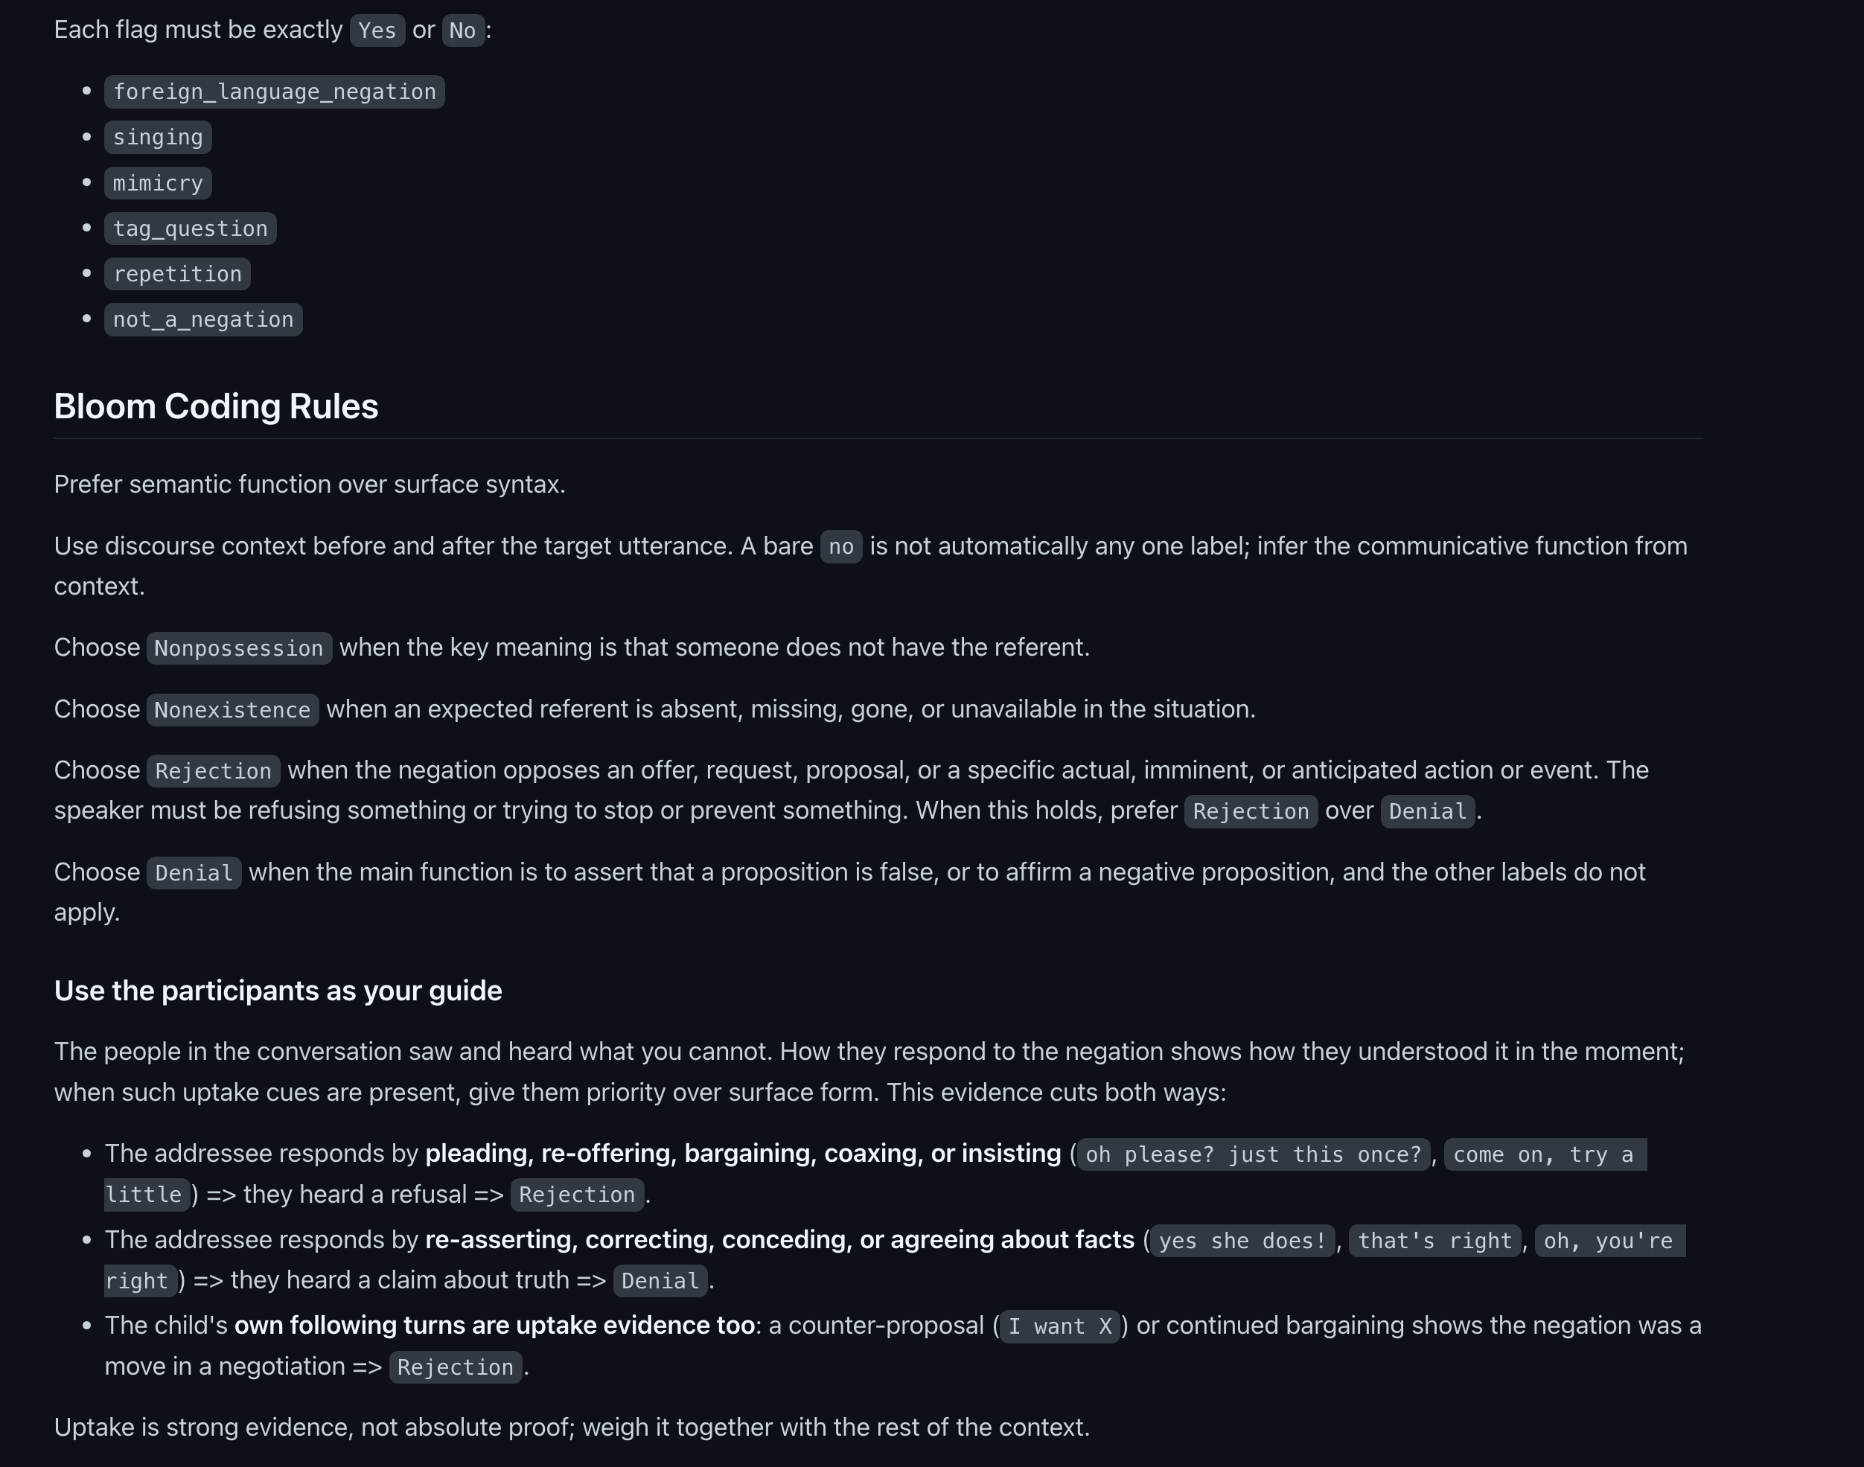
Prompt v3

Slide 21
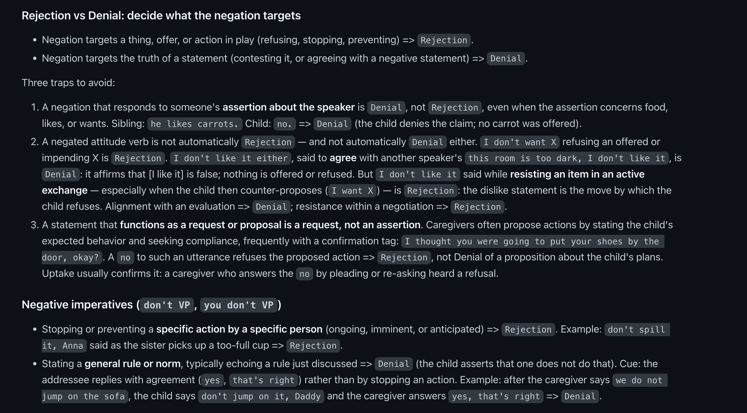
Prompt v3

Slide 22
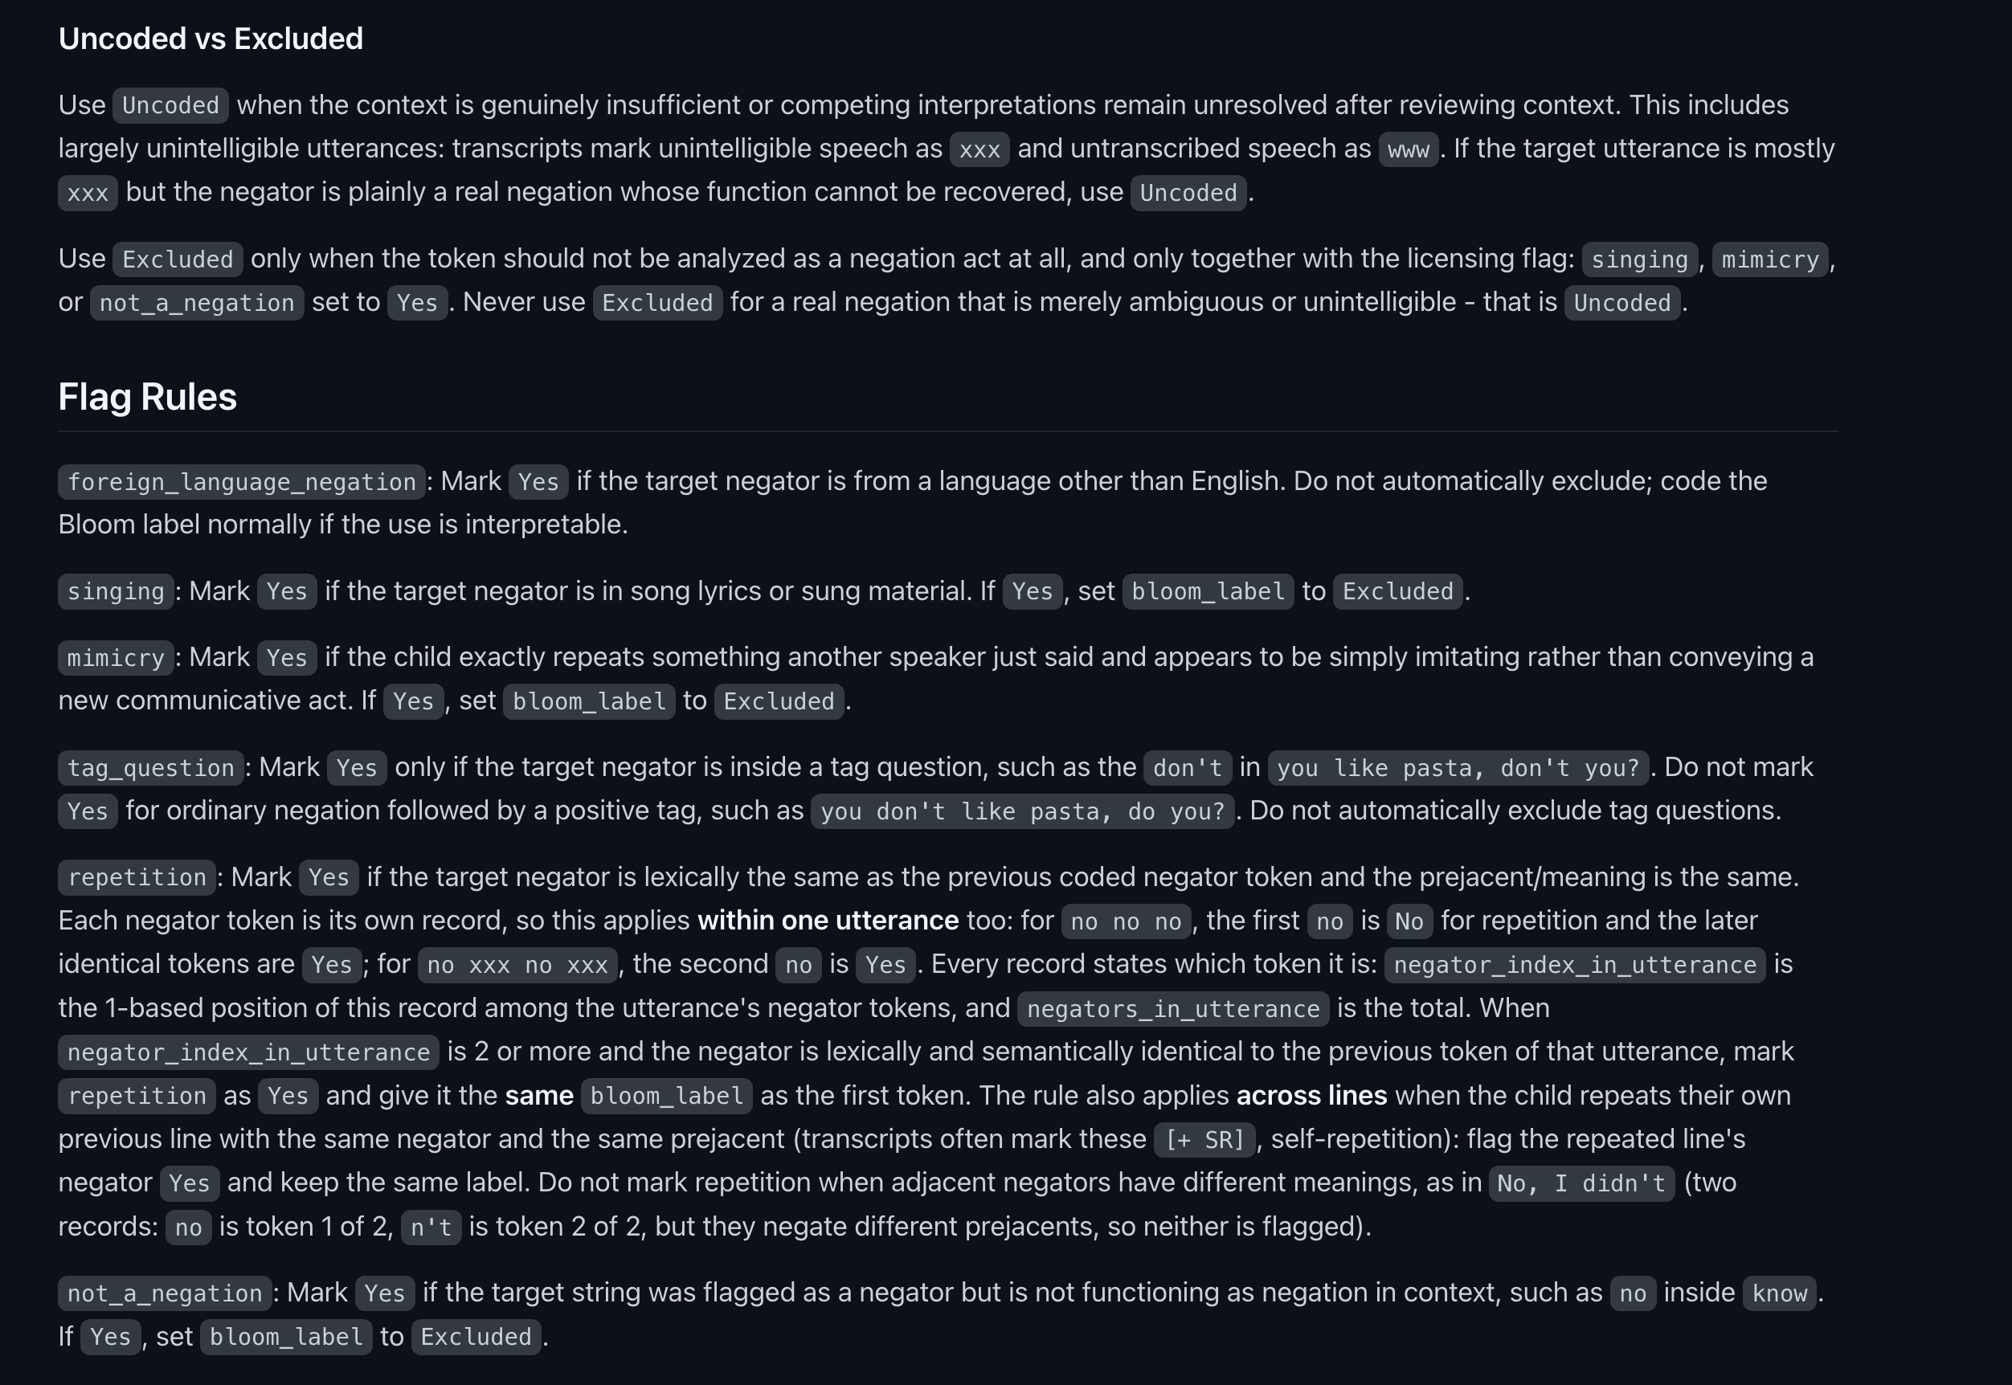
Prompt v3

Slide 23
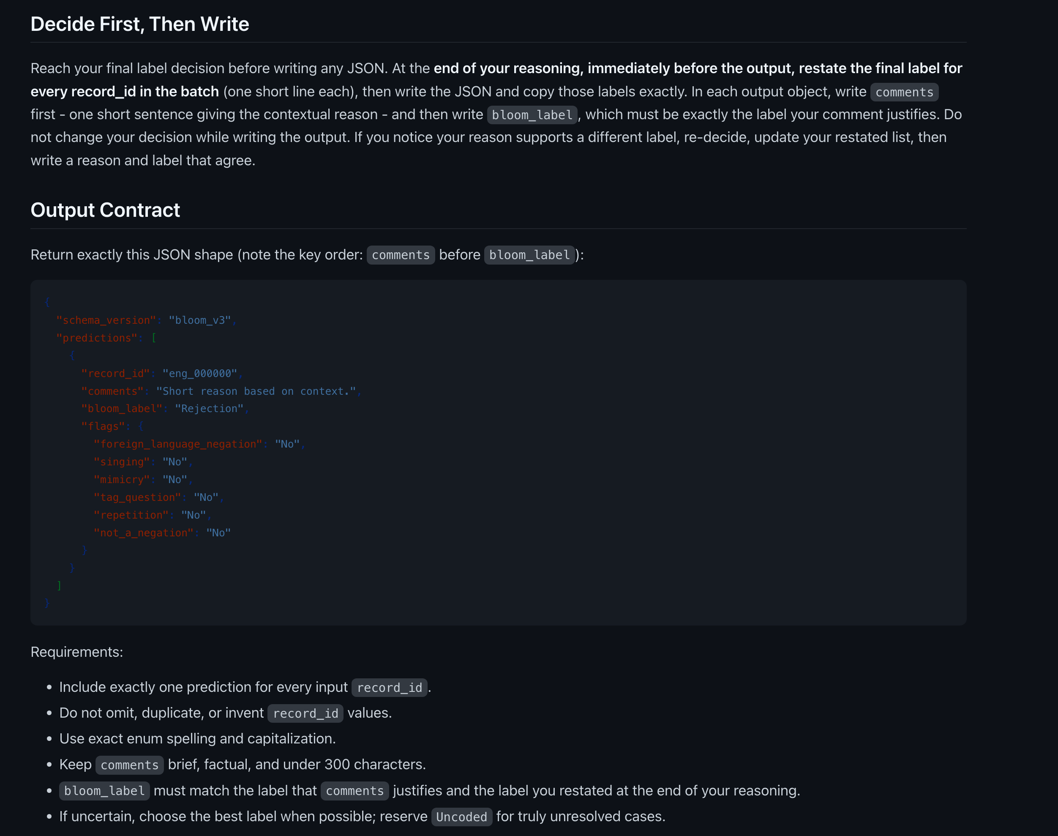
Prompt v3

Slide 24
LLM–human agreement across versions
Prompt contaminated
80 unseen lines

Slide 25
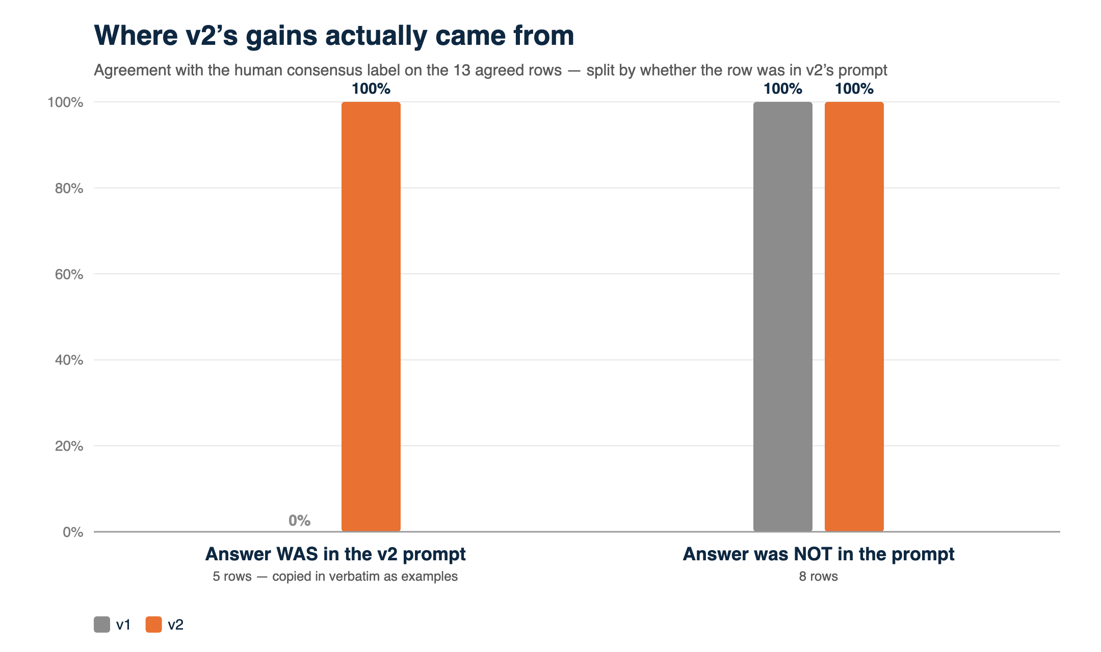
Why v2 looked so good: it was graded on its own answers
v2’s few-shot examples were lifted verbatim from the 20 test rows.
The 5 consensus rows v1 got wrong became examples in the v2 prompt.
v2 then aced those exact 5 rows (0% → 100%) and improved on nothing else (8/8 → 8/8).
So the “above-ceiling” v2 score was memorization, not skill.
Fixed in v3: examples paraphrased, the 20 mined rows excluded from headline metrics, scored on unseen data.

Slide 26
References

Slide 27
Origins of logical thought: Two opposing views
No logical thought without language
Logical thought necessarily precedes language
E.g., Davidson, Bermudez
E.g., Fodor
NEGATION
NEGATION
“no”
“no”
Notes:
Negation as a test case
Logical content
Abstract, compositional meaning
Empirically, it seems hard to learn!

Slide 28
Logical negation emerges late
No (denial)
Not
No (rejection)
No (nonexistence)
No (prohibition)
~ 15 months
~ 27 months
Rejection “Do you want some broccoli?” “No!”
Prohibition “Can I go to the park?” “No!”
Nonexistence “Is there any milk?” “No!”
Denial “Is Pluto a planet?” “No!”
Bloom, 1970
Notes:
Another reason that negation is a good case study is that it seems to be hard– children don’t produce “no” to mean denial, nor understand “no” or “not” to mean denial, until after their second birthday (according to much of the existing body of work)
One reason to think these are separate concepts is that kids express them long before denial; another reason is that they’re separate words in tagalog
Reasons to think early negation might be function-specific
They use it specifically, according to some accounts
They fail comprehension tasks until later
They hear no as a one-word rejection/prohibition, and it’s easier to identify in those contexts (hsp)

Slide 29
Specific functions may imply specific meanings
Context
“No!”
Children’s first uses of “no” seem to be function-specific
The concept is available to map to language
Lexicalized in some languages (e.g., Tagalog)
"no" can reject even when there isn’t obvious want in the linguistic context
Rejection/prohibition meanings are easier to identify in isolation (Gomes et al., 2023)
REJECT
NEG
want
Speech act: Rejection
Meaning: REJECTION
Speech act: Rejection
Meaning: NEGATION
Notes:
The argument is not ‘no must have the meaning rejection’, it’s ‘children likely hypothesize that no means rejection’
And further, that this hypothesis is likely in English, but not Tagalog

Slide 30
What makes negation hard?
No (denial)
Not
No (rejection)
No (nonexistence)
No (prohibition)
~ 15 months
~ 27 months
CONCEPT LEARNING
LANGUAGE LEARNING
Difficulty learning the concept NEGATION
Difficulty mapping NEGATION to language
Is language learning or concept learning the major bottleneck on children’s acquisition of negation?
Bloom, 1970
Notes:
Does the concept preced the language, or does the language precede the concept?

Slide 31
Language structure may scaffold concept acquisition
WANT : REJECT
ALLOWED : PROHIBITED
EXISTS : NONEXISTENCE
P : NEGATION ( P ) “No!”
REJECTION
NONEXISTENCE
NEGATION
PROHIBITION
??????
“no”
Bermudez (2003); Drozd (1995); Hummer, Wimmer, & Antes (1995) ); Pea (1980)
Notes:
1:00
Our argument is that this clustering of meanings might scaffold the process of concept acquisition, if that is what’s happening
So that could look something like a child noticing a sort of analogy: want has the same relationship to reject as allowed has to prohibited, and as exists has to nonexistence; then, they might abstract away from those specific concepts to discover that any proposition P and it’s negation are also in that same relation. To be very clear, this is not a mechanistically spelled out story, this is merely a way to give you an intuition for what this hypothesis might look like. This proposal has been made several times in the literature, and nobody has given a mechanistic account of how it might happen
The point is though that even without a mechanistic account, this class of proposals makes specific empirical predictions that we can test. In particular, it makes the following prediction:

Slide 32
Language structure may scaffold concept acquisition
English
Tagalog
REJECTION
NONEXISTENCE
REJECTION
NONEXISTENCE
PROHIBITION
NEGATION
PROHIBITION
NEGATION
“no”
“ayaw” “huwag” “wala” “hindi"
Notes:
1:00
In English, all of these specific negative concepts are expressed by a single word, “no”, and so the word ”no” offers a child a convenient pointer to just the concepts they need to be paying attention to in the process of learning negation. In contrast, in Tagalog each of these meanings is expressed by a different word, and so children learning Tagalog don’t get the same leg up in learning the concept negation

Slide 33
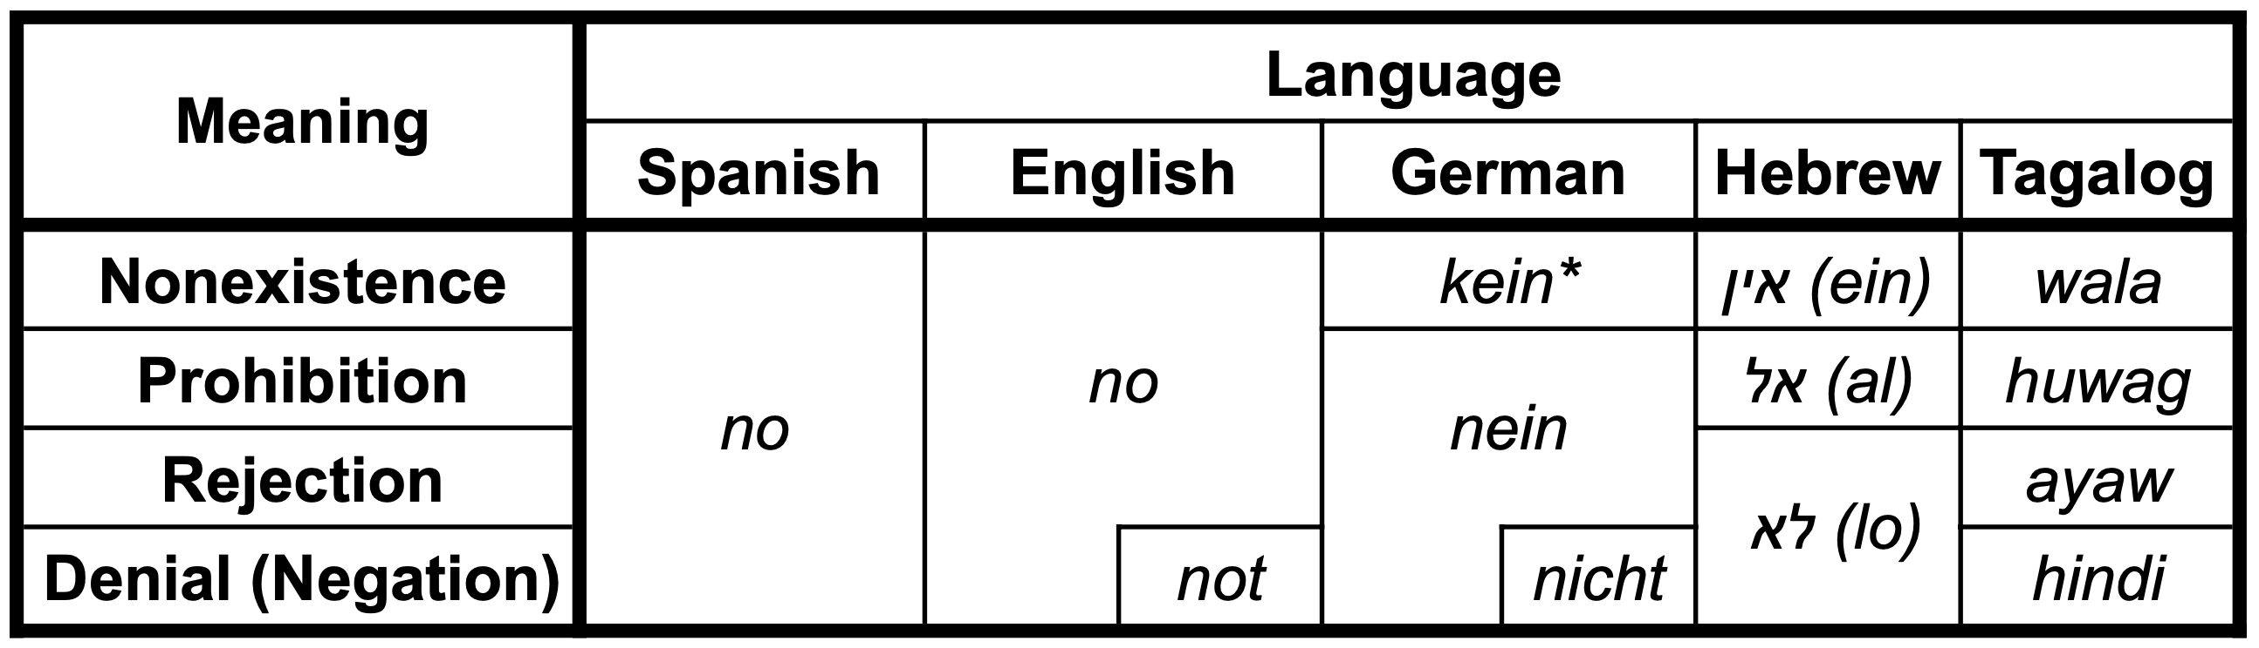
English
Tagalog
more shared negation meanings
fewer shared negation meanings
This side learns denial negation language earlier
This side learns negation faster
CONCEPT LEARNING
Learning the concept NEGATION is
scaffolded by mappings to REJECTION, NONEXISTENCE, and PROHIBITION
Notes:
In a perfect world we would have multiple languages in each category, so this is a starting point and we will want to eventually add to it
not can be used to express r, p, etc, but it must do so compositionally--ie by composing with want to express rejections-- this makes it less likely that not is mapped to a specific concept of rejection, etc.
We included both English and Spanish because we were additionally interested in the presence of a denial-only negator in a language with another multi-function negator, but with our current data it’s hard to get much foothold on that, so I’ll focus on the shared meanings for now, and I’ll briefly discuss the one-to-one negator question at the end/I’d be happy to talk more about that offline

Slide 34
Clustered meanings could inhibit mapping NEGATION to language
Children resist mapping new meanings to a word they have a meaning for (Casenheiser, 2005; Mazzocco, 1997)
Children have an easier time learning homophonous mappings when the meanings are syntactically or semantically distinct (Dautriche et al., 2018)
REJECTION
NONEXISTENCE
PROHIBITION
NEGATION
“no”

Slide 35
Clustered meanings could inhibit mapping NEGATION to language
REJECTION
NONEXISTENCE
REJECTION
NONEXISTENCE
PROHIBITION
NEGATION
PROHIBITION
NEGATION
“no”
“ayaw” “huwag” “wala” “hindi"

Slide 36
English
Tagalog
more shared negation meanings
fewer shared negation meanings
This side learns denial negation language earlier
This side learns denial negation language earlier
This side learns negation faster
CONCEPT LEARNING
LANGUAGE LEARNING
Learning the concept NEGATION is
scaffolded by mappings to REJECTION, NONEXISTENCE, and PROHIBITION
Learning the NEGATION meaning of words is
inhibited by mappings to REJECTION, NONEXISTENCE, and PROHIBITION
Notes:
In a perfect world we would have multiple languages in each category, so this is a starting point and we will want to eventually add to it
We included both English and Spanish because we were additionally interested in the presence of a denial-only negator in a language with another multi-function negator, but with our current data it’s hard to get much foothold on that, so I’ll focus on the shared meanings for now, and I’ll briefly discuss the one-to-one negator question at the end/I’d be happy to talk more about that offline

Slide 37
English
Tagalog
more shared negation meanings
fewer shared negation meanings
This side learns denial negation language earlier
This side learns denial negation language earlier
This side learns negation faster
CONCEPT LEARNING LIMIT
LANGUAGE LEARNING LIMIT
Notes:
In a perfect world we would have multiple languages in each category, so this is a starting point and we will want to eventually add to it
We included both English and Spanish because we were additionally interested in the presence of a denial-only negator in a language with another multi-function negator, but with our current data it’s hard to get much foothold on that, so I’ll focus on the shared meanings for now, and I’ll briefly discuss the one-to-one negator question at the end/I’d be happy to talk more about that offline

